Slide 1
Town Hall
August 31st, 2017

Slide 2
Agenda
COO/CEO Welcome - Tobi
Staff Announcements - Tobi
Spoke Reno - Mark & Ben
Balanced Scorecard - Carrie
September Events Update - Tobi & Mac
Acceptable Use - Geoff Pimlatt
Senior Leadership Team Update - Tobi
Wellness Update - Karla & Cassandra
Front Office/Mustang Central Re-org - Carrie, Vicki, Josh & Nick V
Upcoming Town Halls - Karla
Closing Remarks - Tobi

Slide 3
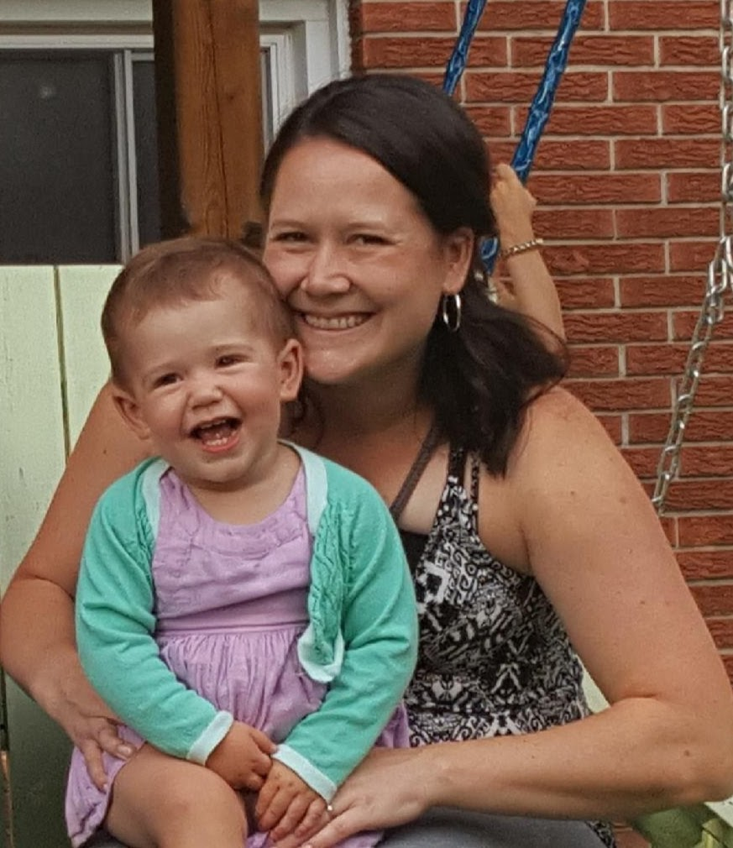
Staff Announcements
Jaclyn Higgins (no longer McKenna)
Jaclyn has bravely taken on the new and exciting Executive Assistant role
This role involves executive support for the COO, 5 Executive Members, and the Board of Directors
Jaclyn Higgins returns from maternity leave as a mom to one of the cutest little Yankee fans around

Slide 4
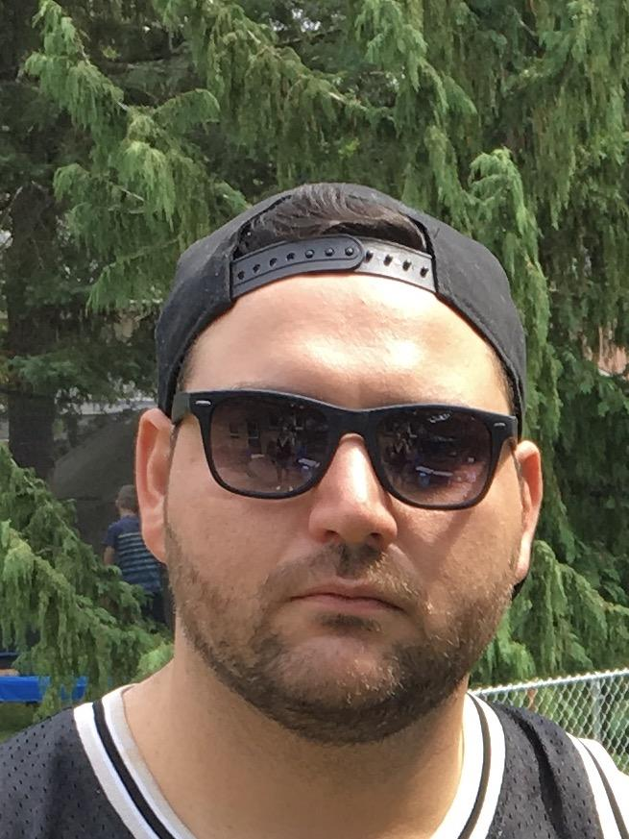
Staff Announcements
Cris Cervoni
The “new and improved” Wave Site Manager (who was the Wave Site Manager before)
Cris takes on the Wave Site Manager role and and makes it look good

Slide 5
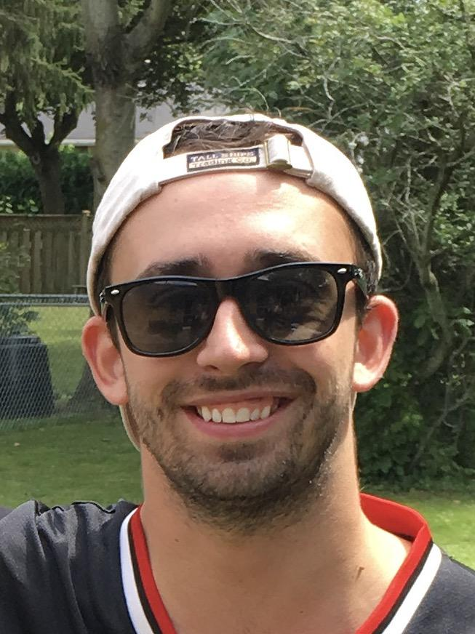
Staff Announcements
Max Bowman
The “new and improved” Wave Night Manager (who was the Wave Night Manager before)
Max takes on the Night Manager role with a smile on his face (and also makes the role look good) however his sunglasses fit better

Slide 6
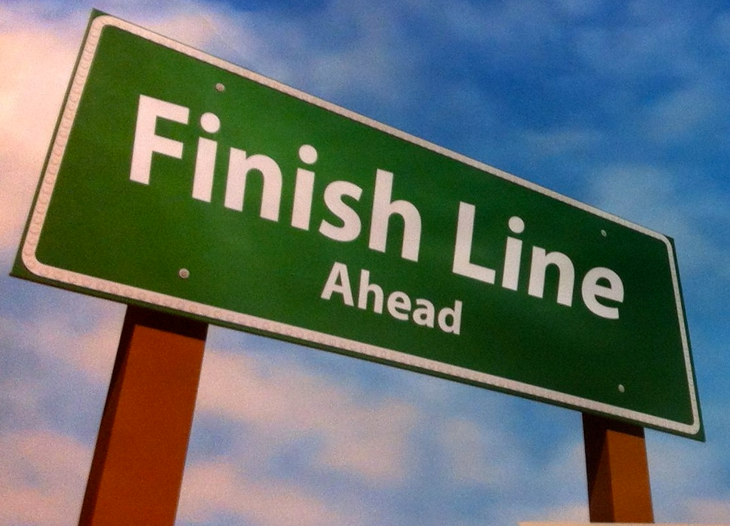

Slide 7
The Spoke Reno - Ben & Mark

Slide 8
The Spoke Reno - Ben & Mark

Slide 9
The Spoke Reno - Ben & Mark

Slide 10
HOURS OF OPERATION
Thursday Aug 31 – final day of construction activities
Friday Sept 01 – Furniture delivered and set-in place
Saturday Sept 02 – P/T staff orientation
Sunday Sept 03 – Open for O-Week business (10am – 10pm)
Monday Sept 04 – Labour Day – Open 10am – 10pm
Tuesday through Friday – 7:30am – midnight
Sat/Sunday – 10am – 10pm
Normal Business hours to resume

Slide 11
UNFINISHED BUSINESS…
There are items in the project that were added to the scope of work after the tender process which will not be complete for the launch
Millwork Items:
Garbage banks
Coffee condiment center
Café line wall
Window seating

Slide 12
Balanced Scorecard Update - Carrie
What Has Been Done?
Senior managers have consulted with their teams to determine goals, outcomes and measures of what success looks like for the outcomes for the various departments.
Senior management has met and discussed the departmental work to ensure that where collaboration across departments and/or where shared resources are required, that departments have access to what they need.
Senior manager Finance and Admin has met with all senior managers to pull out the short term (this year), medium term (next budget) and long term pieces within each of the departmental scorecards.
Budget needs have been identified and are working on determining how best to get the funds required to achieve the goals and outcomes.

Slide 13
Balanced Scorecard Update - Carrie
Next Steps
A request for additional budget funds, where necessary, will be brought forward to the board so that we can get approval to spend outside of the approved budget or from within the contingency dollars
Once approved, we will have a comprehensive set of departmental scorecards for the USC
Final step for the overall USC scorecard will be layering in the platform pieces from the Executive so that we can have a high level picture of how the USC is moving forward
Future
Balanced scorecard will be reviewed and updated in conjunction with the annual budget

Slide 14
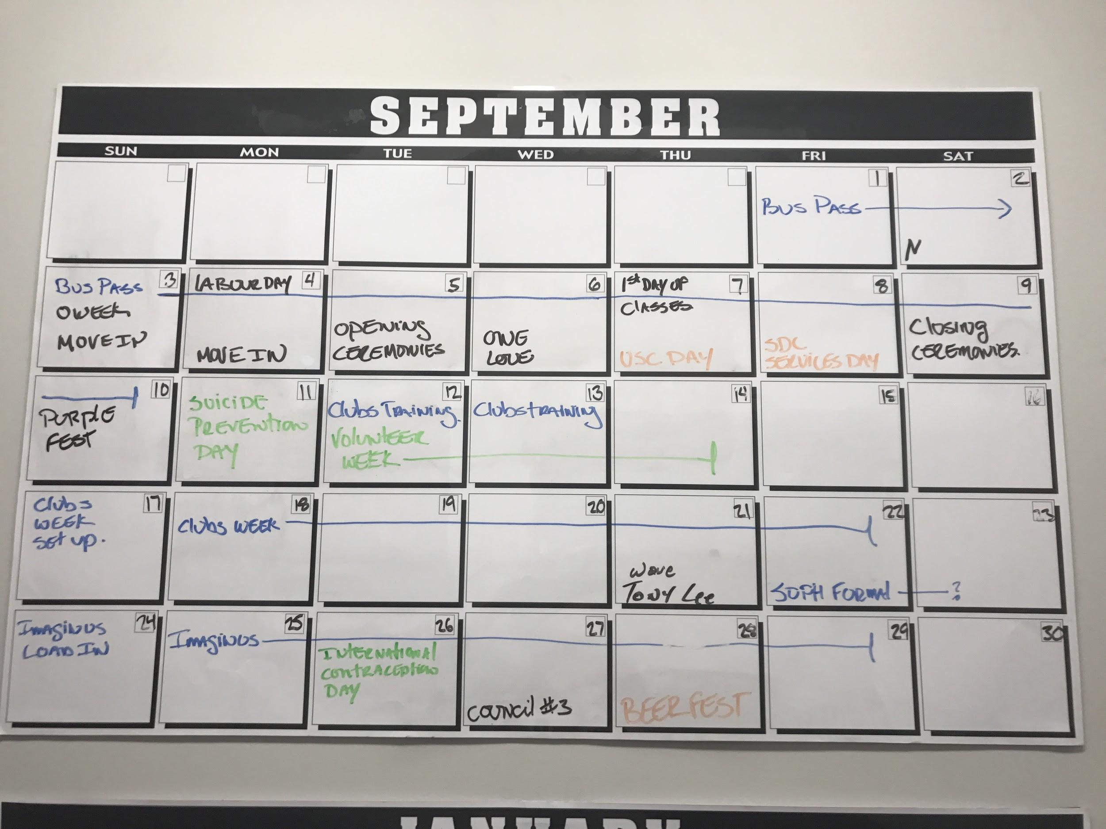
September Events Update - Tobi & Mac

Slide 15
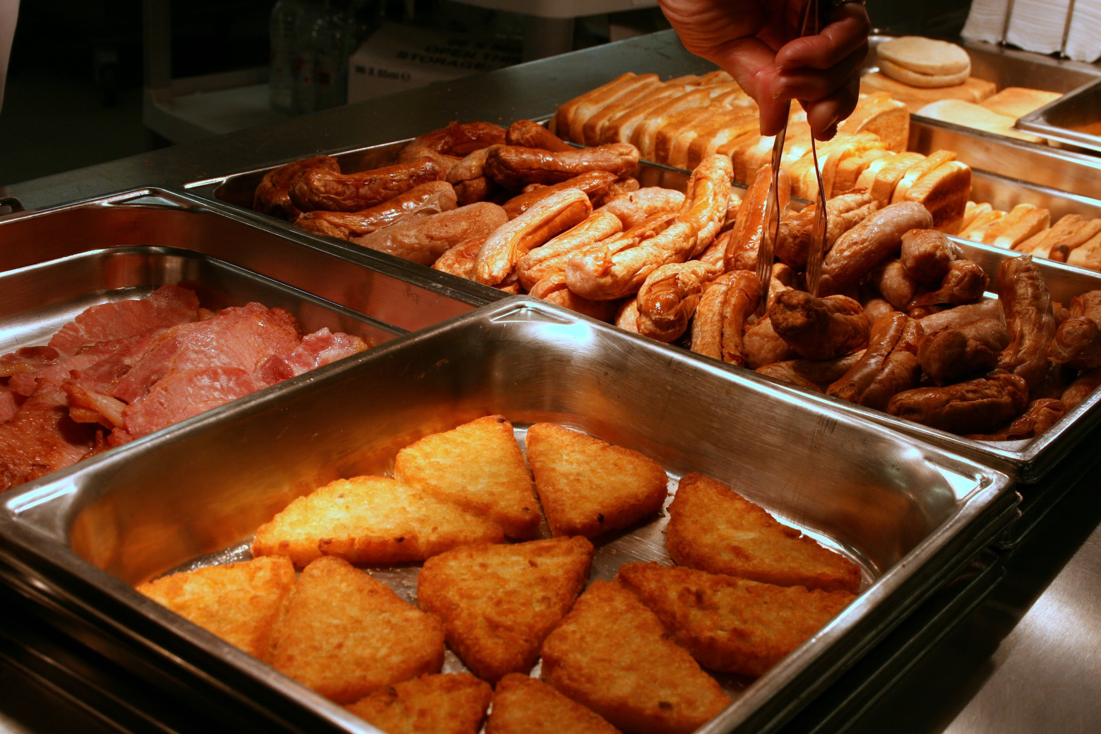
September Events Update - Tobi & Mac
O-Week Line Up
Homecoming
Wave Breakfast Buffet
Clubs Week/Space

Slide 16
September Events Update - Tobi & Mac
USC Events can be found on the shared Google Calendar “USC Public Events”
All USC staff with a @westernusc.ca email address can access this shared calendar
You can add this calendar to your shared google calendar list to keep up to date with all things “USC”

Slide 17
Acceptable Use Policy - Geoff Pimlatt
http://usc-staff.org/documents/
> Policies and Procedures

Slide 18
Senior Leadership Team Update
Senior Leadership Meetings
Minutes can be found on Basecamp under the SLT Group
https://docs.google.com/document/d/1-gXeuDd05oscsxwW_BTEiMR8NXpFowYWe3h8CJrDiEg/edit#
SLT represents Senior Management and the Executive
Meetings occur monthly

Slide 19
Wellness Update - Workouts
USC Workout Schedule
https://docs.google.com/spreadsheets/d/1Cfvy6mcJpZTWNbrIHKJ1LtACekPyYUkPwjRqxWOfUL4/edit?ts=59a58163#gid=0
Associates, Interns and Coordinators invited to participate
Mon, Wed, Fri @ noon; Thurs @ 4:30pm
Variety of programs to be offered for all skill levels with modifications for beginners all the way through to seasoned athletes
Various fitness classes to be offered including High Intensity Interval Training, Martial Arts, Zumba, Tai Chi, etc depending on staff interest
Workout locations subject to change and will include the community room, room 269, the McKellar room, and the great outdoors (checkout the schedule above for details)

Slide 20
Wellness Update - Survey
Wellness Survey will go out this week - looking for honest feedback to shape wellness offerings for the year
Looking to see what staff have attended as well as how they would like to see wellness offerings improve or adapt
Looking for individuals to identify themselves on the survey for the chance to win $25

Slide 21
Wellness Update - Upcoming Events
Workplace Massages - 30 minutes offered throughout the day as a pilot in late September/early October (look for more details)
Intramurals - Basketball & “Do-Gooders”
Yoga on Thursdays starting in October
Wellness Lunches - Changing up departmental salad days and opting for 4 healthy lunches this upcoming year

Slide 22
Front Office/Mustang Central Re-Org
Carrie, Josh, Vicki & Nick V
With no atrium space available to house Mustang Central, it will cease to exist. The service provided by Mustang Central will move to the second position at the 340 Front Desk in the form of a student staffed Reservations Clerk.
General Services Currently Provided By Mustang Central – to be covered by Reservations Clerk
· Reservation and Event bookings in the UCC, including questions about technical services
· Atrium/Lower Level Table Reservation and Event check in
· Atrium activity monitoring – table activities, improper canvassing or sales, spills or maintenance
· A/V Kit pick up and drop off for Conference Rooms and Council Chambers
· Bus Pass/Mustang Express sticker distribution/Some Lost and Found
· Building Occupant Mail Distribution
· Health/Dental plan inquiries
· Clubs locker distribution and maintenance
· Directions building room locations and Campus buildings
· Campus related inquiries (services and all related aspects)
· City of London related questions (bus routes)
· Maintenance of microwaves and other minor housekeeping
· Handling of banner inquiries

Slide 23
Front Office/Mustang Central Re-Org
Carrie, Josh, Vicki & Nick V
This change brings a student face to the front desk through the day, and into the evening with extended front desk hours, until 9pm.
Along with the benefit of bringing the a/v sign-out bags closer to the conference center. As the Reservations Clerks are hired from the student crue pool, they will be available to provide quick service to these rooms.
As Mustang Central was a central information point in the atrium, the Purple Store staff will take on a stronger role of providing information – and we will be sharing the staff information site that Mustang Central part time staff used as an information go-to.
We are currently looking to hire a PT person to perform finance duties who will reside at the front desk as well. They will enable extended hours at the front desk for: float pickups/replenishment, cheque pickups, dropping off cheque recs, etc. This person will also be there until 9pm.

Slide 24
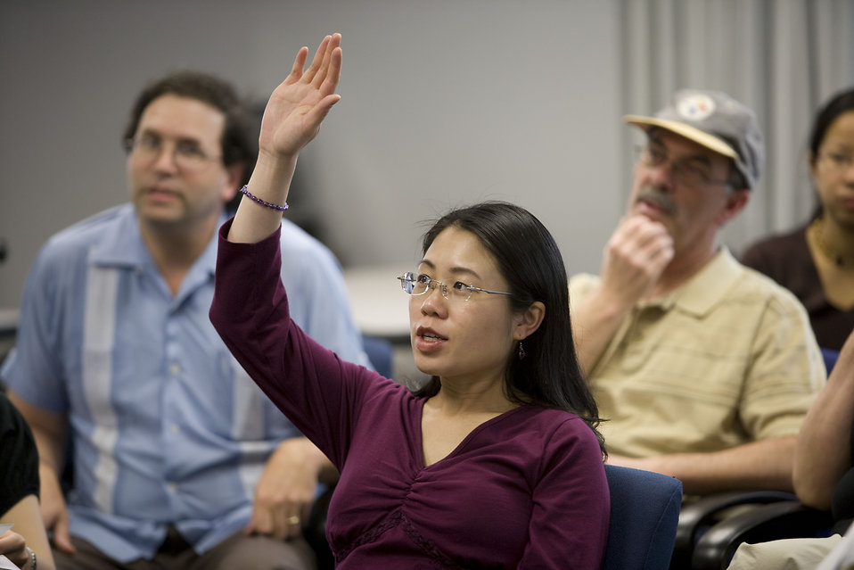
Upcoming Town Halls
Harvest Breakfast - October 31st
Next Town Hall - November 29th

Slide 25
Closing Remarks - Tobi & Jeff

