Slide 1
USC TOWN HALL
Tuesday, August 24th, 2015
“Seventy percent of success in life is showing up”. — Woody Allen

Slide 2
AGENDA
Announcements
2014 Holiday Closure
Engagement Update – Geoff & Karla
HOCO Update – Jeff & Mark
Purple Store Presentation - Becky
Performance Appraisal/Professional Development Changes – Karla
Google Calendars – Geoff & Karla
Total Compensation Statements – Karla
Wellness Update & Fitbit Draw - Cassandra
Union Meeting

Slide 3
2015/16 Holiday Closure
Last day of Exams
WEDNESDAY, December 23rd, 2015
Last day of Work
FRIDAY, December 18th, 2015
Holiday Break begins:
MONDAY, December 21st , 2015
Return to work from Holiday Break:
MONDAY, January 5th, 2015
Monday December 21st & 22nd are a Holiday Gift from the USC
No need to take vacation days.
Enjoy your break!!!

Slide 5
Staff Engagement Update
Insert Presentation
Show role profiles and sunshine moment on HUB {Insert Link}
Next Roundtable session November

Slide 6
Staff Engagement Update
Professional Development
Focused discussion in PA to learn more and grow in your job. (Completed - PA Process Change)
Training for Managers on motivation / coaching. (Pending)
Staff course and PD opportunities to be marketed better:
Develop outline of general courses that people can take (i.e. leadership courses). (On-going)
Resources to be posted to Staff Hub. (Pending)
Town Halls – HR to talk about PD and clarify before October when PD is due. (Completed)

Slide 7
Staff Engagement Update
Engendering a Sense of Community
Stories that relate back to the mission of the USC . (On-going)
Events that get staff out of the familiar / mix with different people. (On-going)
Communicate departmental success. (On-going)
“Did you know” posting on HUB. (Pending)
Evaluate opportunities for job shares / cross training. (Pending – CBA / LMRC)
A map of where we have come and where we are now. (Pending)

Slide 8
Staff Engagement Update
Recognition
Peer recognition for above-and-beyond (i.e. sunshine moment). (Completed)
Form available on the Hub. (Completed)

Slide 9
Staff Engagement Update
MISC:
Keep investing in corporate wellness; easy place to cut expenses but does so much for employee satisfaction. (On-going)
Flexibility to take time off during the year by decreasing salary over a period of time and taking a paid leave for family, travel, education, personal interests. (Pending – CBA / LMRC)
Continue to investigate the relationship between union and non-union roles, with an eye to ensuring an equitable balance. (Pending - CBA / LMRC)
Ensure managers are consulted / involved in Senior Leadership decision making process. (On-going)

Slide 10
Staff Engagement Update
OTHER:
Creation and distribution of Role Profiles. (Completed)
http://usc-staff.org/directory/

Slide 11
HOCO 2015
Sophie, Jeff, Mark and Josh

Slide 12
Purple Store Presentation
BECKY

Slide 13
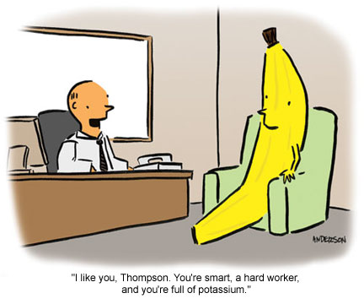
Performance Assessment/Professional Development Changes

Slide 14
Performance Assessment/Professional Development Changes
Union and Non-Union staff will use same mid-year goal setting Performance Assessment form
Form
Union staff will also be assessed using current PA form in conjunction with mid-year goal setting PA
PA’s will be sent out during first week of September and will be due October 30th
Professional Development is part of goal setting document
Allows for individual PD assessment during November
Final PD requests due from Senior Managers on December 1st

Slide 15
Performance Assessment/Professional Development Changes
Staff will have more involvement and time to identify PD opportunities which will reside departmentally
PD approvals will be communicated in March once the budget is approved
Year-end PA’s will continue with the same qualitative form and due date will be April 30th
Role Profiles will be reviewed through year-end PA process
Union partnering with new process
Support session will be scheduled for late September to assist those responsible for PA’s in navigating through the new process

Slide 16
GOOGLE CALENDARS
Karla & Geoff

Slide 17
GOOGLE CALENDARS
Goal is for all USC Staff to have a westernusc.ca email account activated by October 30th, 2015
Google Calendars will allow us to create a shared staff vacation calendar
Allows for greater communication, meeting requests and viewing staff availability
Training and set-up can be coordinated through Chris Noble
{Insert Photo}

Slide 18
Total Compensation Statements
All permanent full-time staff will receive a total compensation statement in mid-September
Will reflect your total compensation for the 2014/15 fiscal year
The USC is committed to a total compensation perspective that views compensation as salary, benefits, pension, staff programs, paid time off and professional/personal development
Staff will receive a statement that breaks down their individual compensation
Staff Programs will include the budget for programs like wellness divided by the total # of employees to reflect the cost per person for the program
Will be individual, confidential documents
The USC believes in balance Not just about pay.
http://www.ted.com/talks/simon_sinek_how_great_leaders_inspire_action

Slide 19
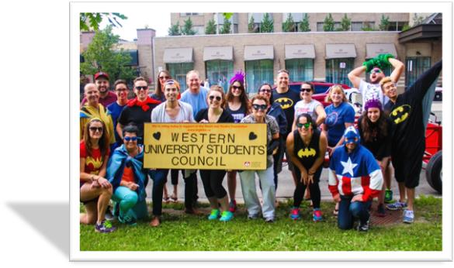
WELLNESS UPDATE {New PHOTO}

Slide 20
UPCOMING WELLNESS EVENTS
Intramurals
Yoga @ Lunchtime starts October 2nd
10 weeks
Thanksgiving Cooking Class – week of October 6th
Life Coach – November
Next Wellness Committee Meeting – This Friday, August 28th from noon – 1pm in room 369
*New Members always welcome*

Slide 21
STEP IT UP CHALLENGE FITBIT DRAW
Participants in weekly challenge have the opportunity to enter a ballot for a FITBIT of their choice
AND THE WINNER IS …

Slide 22
UNION MEETING
Union Staff Only

Slide 23
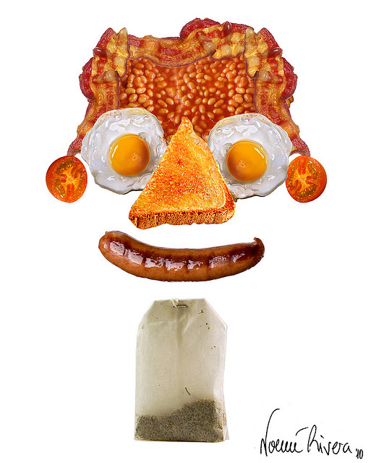
UNION MEETING
Harvest Breakfast – Tentatively booked for Tuesday, October 27th

